Slide 1


BEHAVIOUR AND DESIGN OF WELDED STEEL AND ALUMINIUM I-BEAMS AND BEAM-COLUMNS
Kokou ATTIOGBE
Département de Génie Civil – Université Laval
Québec, Canada
kokou.attiogbe.1@ulaval.ca
Notes:
Hi everyone, Today, I will present some…. Overviews & Specifications of Aluminum I Beam Project for Pedestrian Bridges.
Then after that we can discuss more about it, to find out the way that we can work to bring out the estimate results.

Slide 2
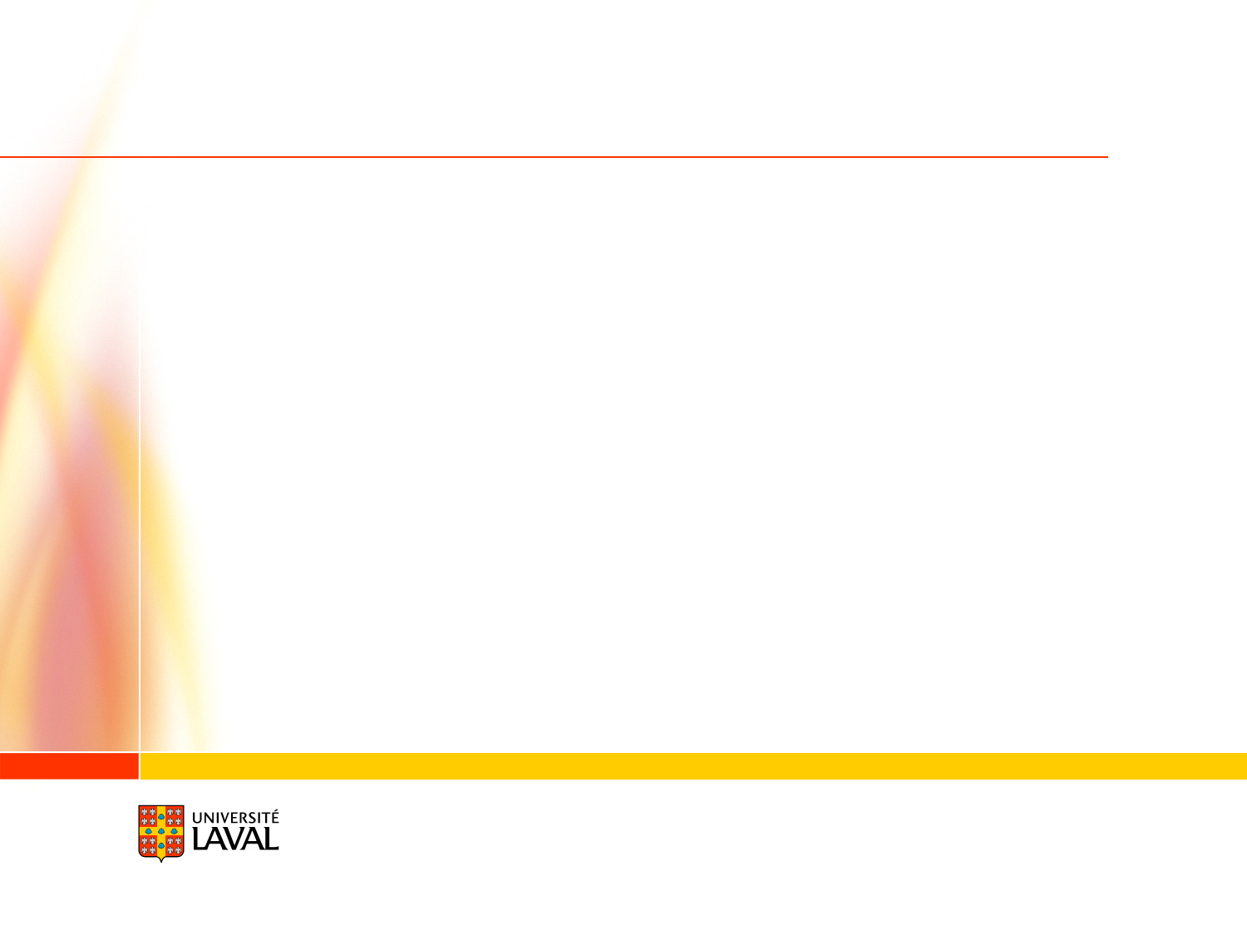

1. Design aluminium I-beam
Numerical model
need to modify the function *test_all. According to the number of node
www.ulaval.ca
Notes:
All beams are going to be fabricated using fillet welds from 3 different plates along their lengths.
The classes of sections are 2 & 3 to consider the shortcoming of current designs

Slide 3
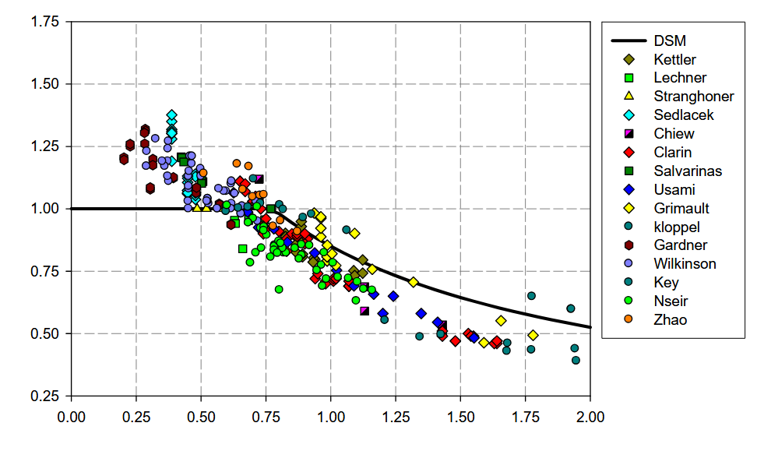
1. Design steel beam-column
Experimental data:
Total number = 13
Goal
PhD Joanna_Nseir
www.ulaval.ca
Notes:
All beams are going to be fabricated using fillet welds from 3 different plates along their lengths.
The classes of sections are 2 & 3 to consider the shortcoming of current designs

Slide 4
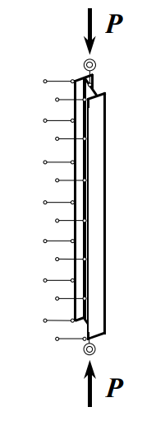
1. Design steel beam-column
Experimental data:
PhD Villette
www.ulaval.ca
Notes:
All beams are going to be fabricated using fillet welds from 3 different plates along their lengths.
The classes of sections are 2 & 3 to consider the shortcoming of current designs

Slide 5
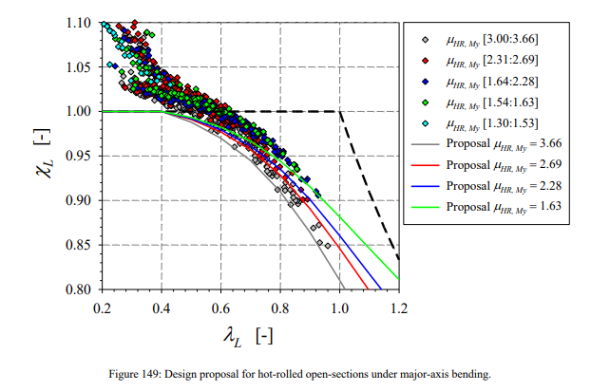
1. Design steel beam-column
Experimental data:
Thesis_Lucile
www.ulaval.ca
Notes:
All beams are going to be fabricated using fillet welds from 3 different plates along their lengths.
The classes of sections are 2 & 3 to consider the shortcoming of current designs

Slide 6
1. Design steel beam-column
Experimental data:
www.ulaval.ca
Notes:
All beams are going to be fabricated using fillet welds from 3 different plates along their lengths.
The classes of sections are 2 & 3 to consider the shortcoming of current designs

Slide 7
1. Design steel beam-column
Numerical model :
www.ulaval.ca
Notes:
All beams are going to be fabricated using fillet welds from 3 different plates along their lengths.
The classes of sections are 2 & 3 to consider the shortcoming of current designs

Slide 8
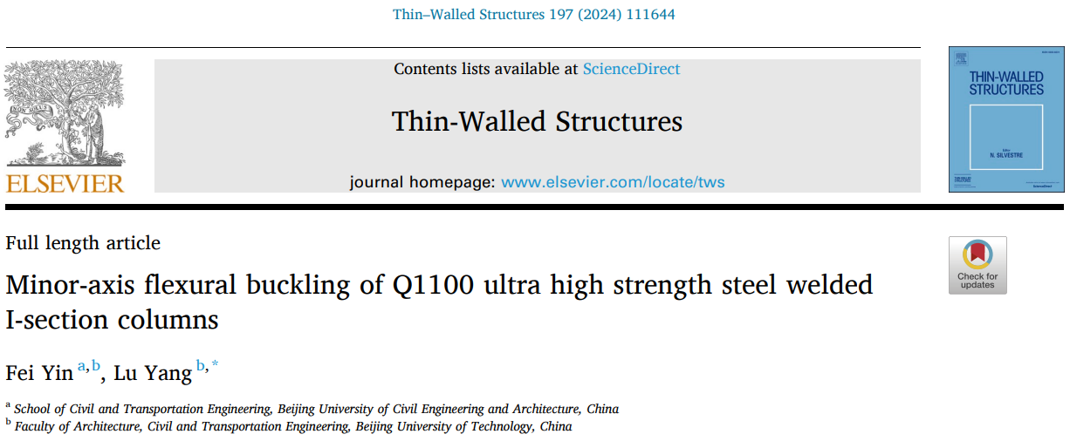
1. Design steel column : welded sections
Experimental data:
Validation # 2 : Minor-axis flexural buckling of Q1100 ultra high strength steel welded I-section columns (2024) by Fei Yin and Lu Yang
www.ulaval.ca
Notes:
All beams are going to be fabricated using fillet welds from 3 different plates along their lengths.
The classes of sections are 2 & 3 to consider the shortcoming of current designs

Slide 9
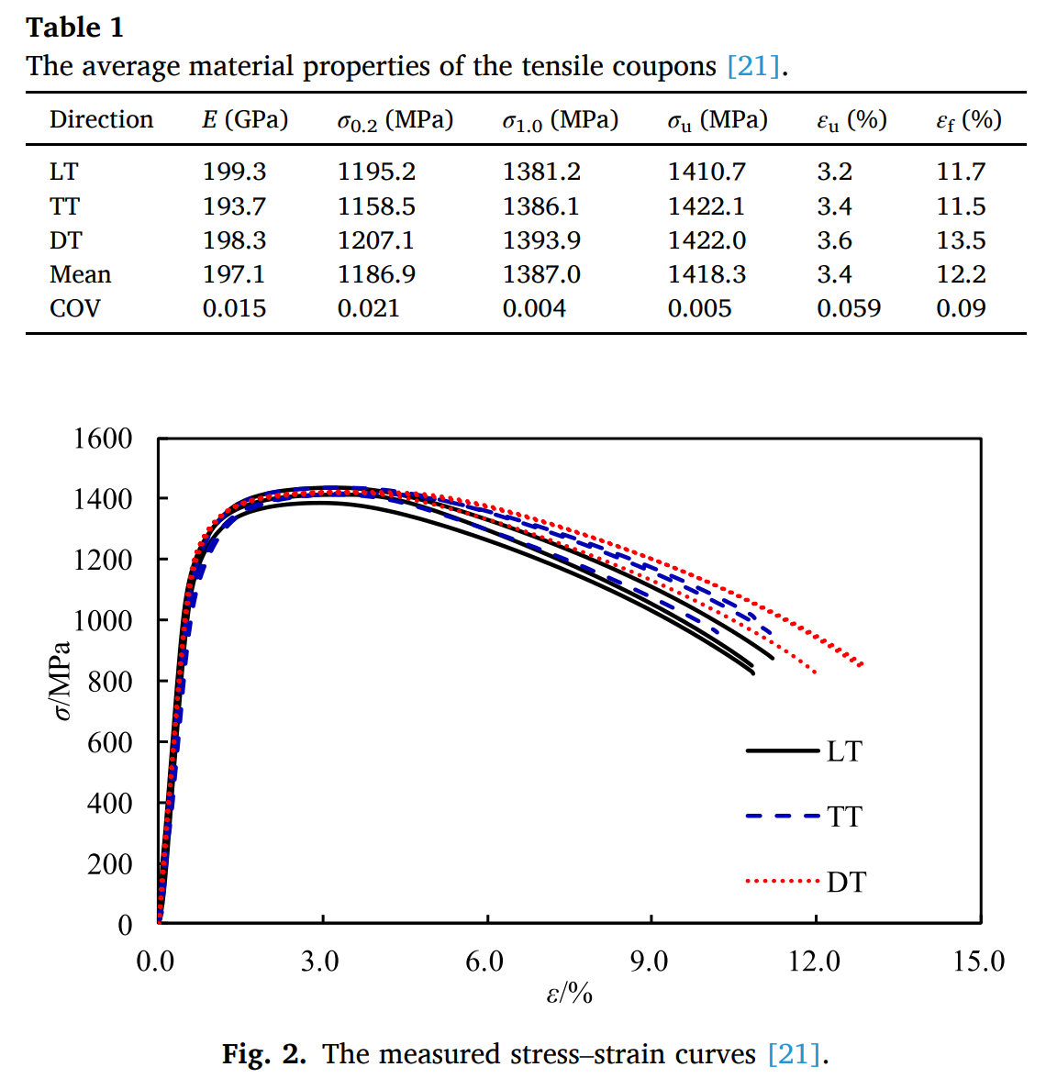
1. Design steel column : welded sections
Experimental data:
Validation # 2 : Minor-axis flexural buckling of Q1100 ultra high strength steel welded I-section columns (2024) by Fei Yin and Lu Yang
Stress-strain curves
www.ulaval.ca
Notes:
All beams are going to be fabricated using fillet welds from 3 different plates along their lengths.
The classes of sections are 2 & 3 to consider the shortcoming of current designs

Slide 10
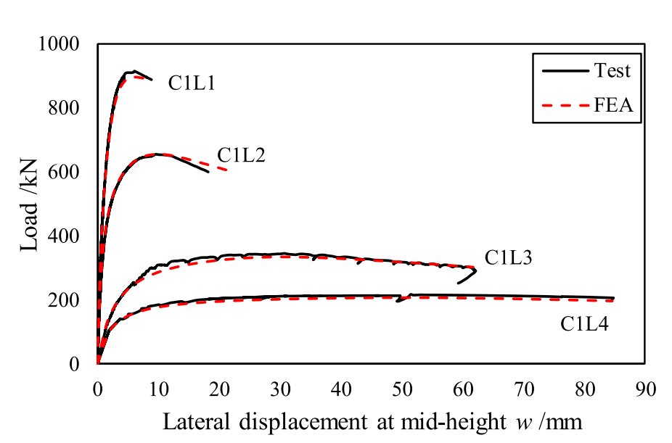
1. Design steel column : welded sections
Experimental data:
Validation # 2 : Minor-axis flexural buckling of Q1100 ultra high strength steel welded I-section columns (2024) by Fei Yin and Lu Yang
www.ulaval.ca
Notes:
All beams are going to be fabricated using fillet welds from 3 different plates along their lengths.
The classes of sections are 2 & 3 to consider the shortcoming of current designs

Slide 11
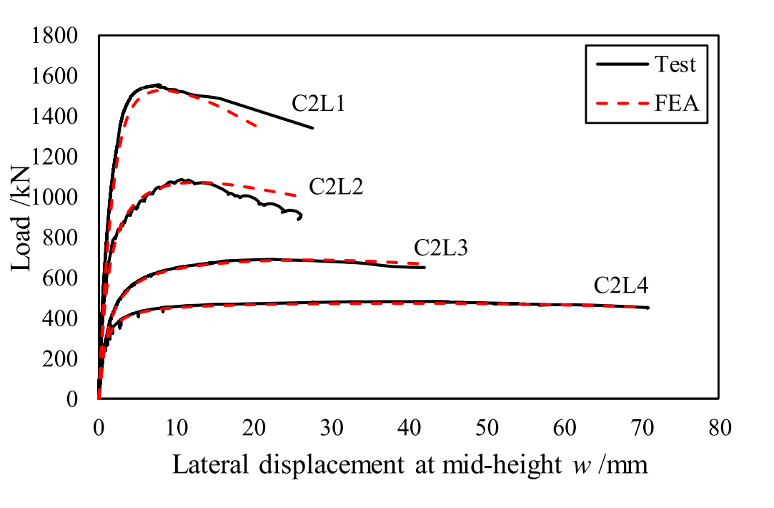
1. Design steel column : welded sections
Experimental data:
Validation # 2 : Minor-axis flexural buckling of Q1100 ultra high strength steel welded I-section columns (2024) by Fei Yin and Lu Yang
www.ulaval.ca
Notes:
All beams are going to be fabricated using fillet welds from 3 different plates along their lengths.
The classes of sections are 2 & 3 to consider the shortcoming of current designs

Slide 12
1. Design steel column : welded sections
Experimental data:
Validation # 2 : Minor-axis flexural buckling of Q1100 ultra high strength steel welded I-section columns (2024) by Fei Yin and Lu Yang
49 | Pu__{exp} | Pu_{_EF} |  |  | Pu_{_EF}/Pu_{_exp}
 |  | w0=bf/100 | w0=bf/200 | w0=bf/300 | w0=bf/100 | w0=bf/200 | w0=bf/300
C1L1 | 915.6 | 912.98 | 929.97 | 931.93 | 1.00 | 1.02 | 1.02
C1L2 | 656.33 | 657.56 | 669.56 | 671.97 | 1.00 | 1.02 | 1.02
C1L3 | 345.19 | 333.86 | 337.71 | 338.41 | 0.97 | 0.98 | 0.98
C1L4 | 217.3 | 207.28 | 209.47 | 209.94 | 0.95 | 0.96 | 0.97
C2L1 | 1556.83 | 1500.83 | 1547.90 | 1595.94 | 0.96 | 0.99 | 1.03
C2L2 | 1087.71 | 1044.19 | 1075.03 | 1100.82 | 0.96 | 0.99 | 1.01
C2L3 | 692.05 | 657.94 | 691.68 | 700.41 | 0.95 | 1.00 | 1.01
C2L4 | 483.05 | 457.28 | 475.48 | 479.69 | 0.95 | 0.98 | 0.99
Mean |  |  |  |  | 0.97 | 0.99 | 1.00
COV |  |  |  |  | 2.01% | 1.76% | 2.02%
www.ulaval.ca
Notes:
All beams are going to be fabricated using fillet welds from 3 different plates along their lengths.
The classes of sections are 2 & 3 to consider the shortcoming of current designs

Slide 13
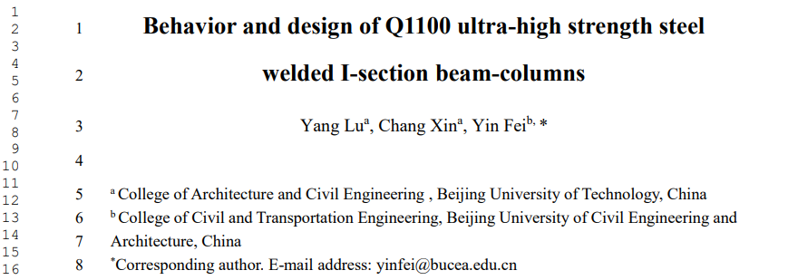
1. Design steel column : welded sections
Experimental data:
Validation # 3 : Behavior and design of Q1100 ultra-high strength steel welded I-section beam-columns (2026) by Yang Lu and Fei Yin
www.ulaval.ca
Notes:
All beams are going to be fabricated using fillet welds from 3 different plates along their lengths.
The classes of sections are 2 & 3 to consider the shortcoming of current designs

Slide 14
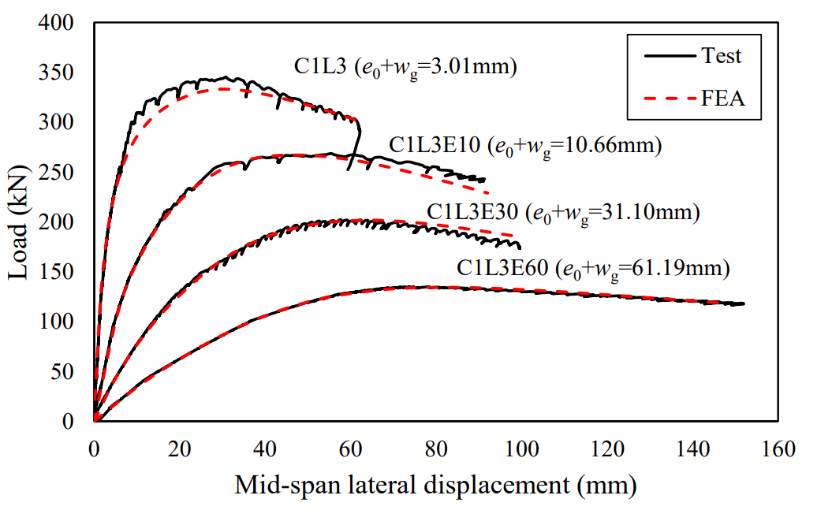
1. Design steel column : welded sections
Experimental data:
Validation # 3 : Behavior and design of Q1100 ultra-high strength steel welded I-section beam-columns (2026) by Lu Yang and Fei Yin
Validation # 3 : Minor-axis flexural buckling of Q1100 ultra high strength steel welded I-section columns (2024) by Fei Yin and Lu Yang
www.ulaval.ca
Notes:
All beams are going to be fabricated using fillet welds from 3 different plates along their lengths.
The classes of sections are 2 & 3 to consider the shortcoming of current designs

Slide 15
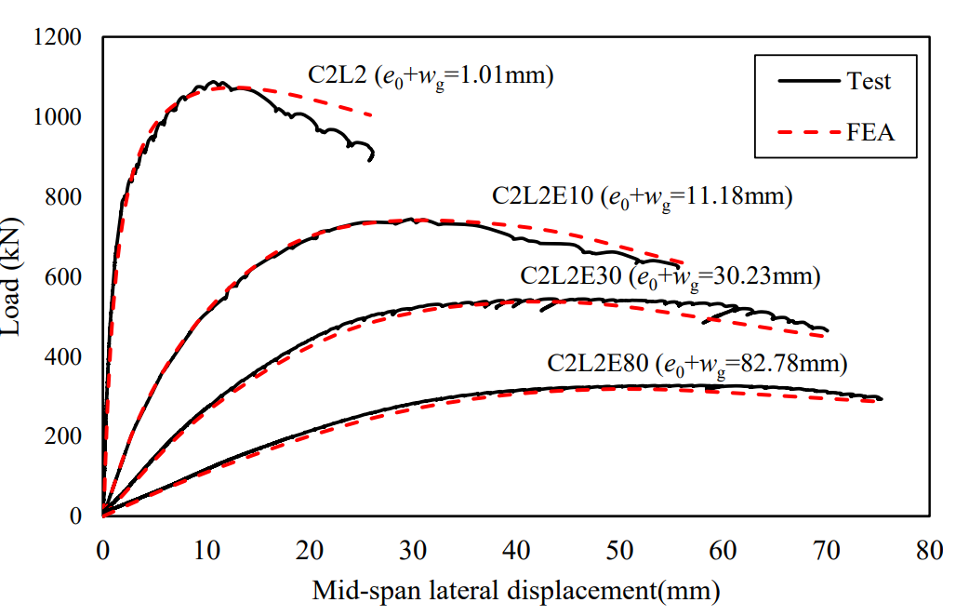
1. Design steel column : welded sections
Experimental data:
Validation # 3 : Behavior and design of Q1100 ultra-high strength steel welded I-section beam-columns (2026) by Lu Yang and Fei Yin
www.ulaval.ca
Notes:
All beams are going to be fabricated using fillet welds from 3 different plates along their lengths.
The classes of sections are 2 & 3 to consider the shortcoming of current designs

Slide 16
1. Design steel column : welded sections
Experimental data:
Validation # 3 : Behavior and design of Q1100 ultra-high strength steel welded I-section beam-columns (2026) by Lu Yang and Fei Yin
 | Pu__{exp} | Pu_{_EF} |  |  | Pu_{_EF}/Pu_{_exp}
 |  | w0=b/100 | w0=b/200 | w0=b/300 | w0=b/100 | w0=b/200 | w0=b/300
C1E10 | 268.48 | 269.76 | 272.40 | 272.85 | 1.00 | 1.01 | 1.02
C1E30 | 202.03 | 204.56 | 206.13 | 206.38 | 1.01 | 1.02 | 1.02
C1E60 | 134.85 | 156.02 | 157.14 | 157.30 | 1.16 | 1.17 | 1.17
C2E10 | 743.99 | 692.09 | 733.79 | 747.82 | 0.93 | 0.99 | 1.01
C2E30 | 543.96 | 504.78 | 531.07 | 541.13 | 0.93 | 0.98 | 0.99
C2E80 | 327.29 | 308.77 | 322.41 | 328.26 | 0.94 | 0.99 | 1.00
Mean |  |  |  |  | 1.00 | 1.02 | 1.03
COV |  |  |  |  | 7.99% | 6.33% | 5.77%
www.ulaval.ca
Notes:
All beams are going to be fabricated using fillet welds from 3 different plates along their lengths.
The classes of sections are 2 & 3 to consider the shortcoming of current designs

Slide 17
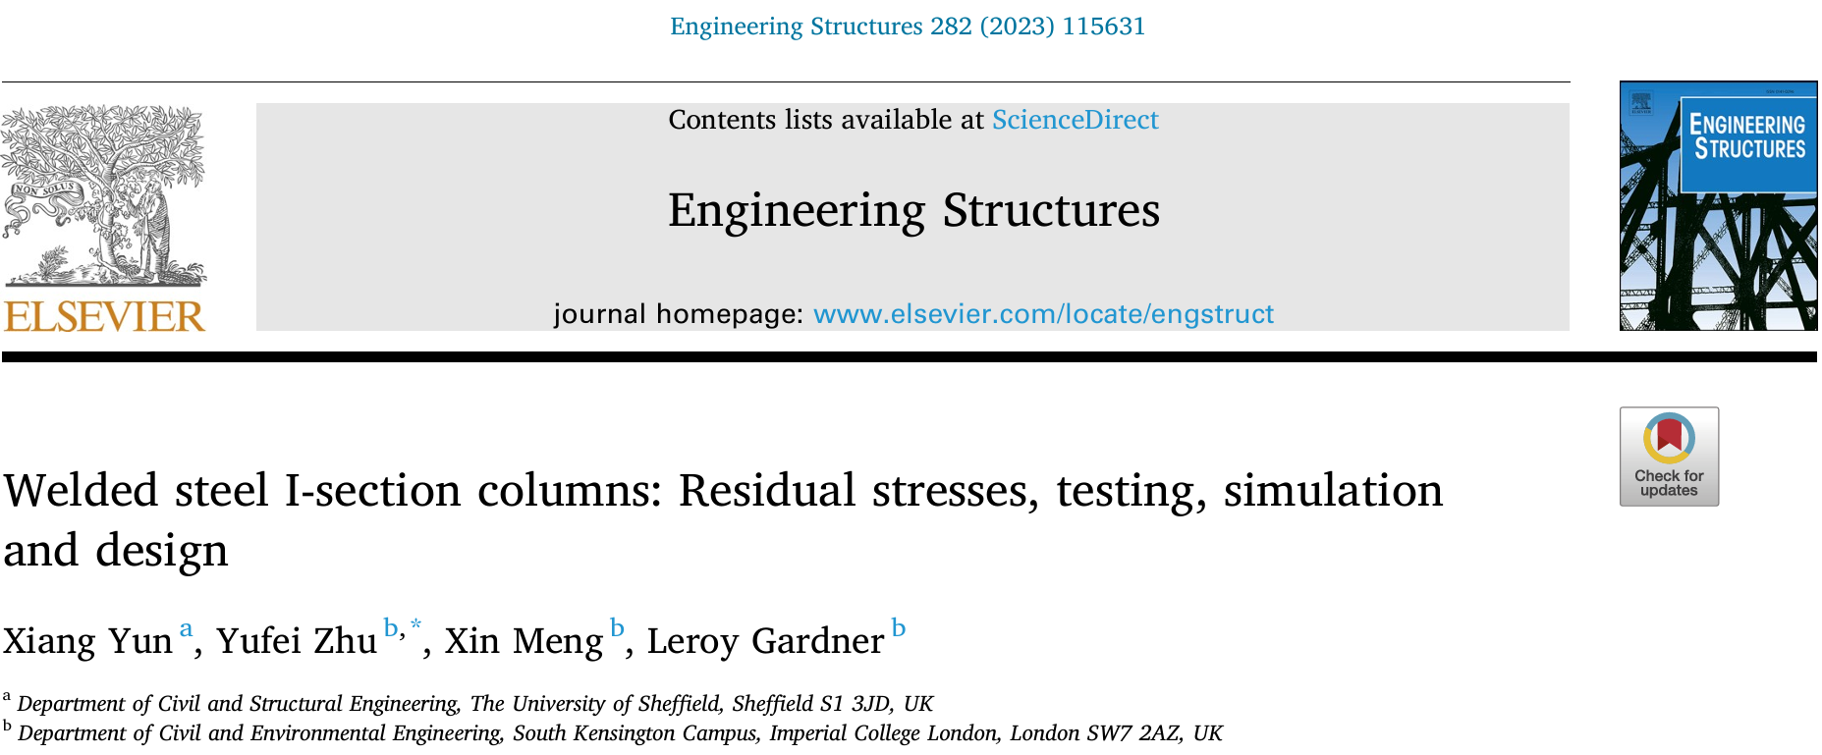
1. Design steel column : welded sections
Experimental data:
Validation # 4 : Welded steel I-section columns (S690): Residual stresses, testing, simulation and design (2023) by Xiang Yun, Leroy Gardner
www.ulaval.ca
Notes:
All beams are going to be fabricated using fillet welds from 3 different plates along their lengths.
The classes of sections are 2 & 3 to consider the shortcoming of current designs

Slide 18
1. Design steel column : welded sections
Experimental data:
Validation # 4: Welded steel I-section columns: Residual stresses, testing, simulation and design (2023) by Xiang Yun, Leroy Gardner (S690)
 | Pu__{exp} | Pu_{_EF} |  |  | Pu_{_EF}/Pu_{_exp}
 |  | w0=b/100 | w0=b/200 | w0=b/300 | w0=b/100 | w0=b/200 | w0=b/300
HSS-I1-C | 1158.2 | 1077.97 | 1086.63 | 1085.23 | 0.93 | 0.94 | 0.94
HSS-I1-C-R | 1079.2 | 1079.66 | 1088.68 | 1087.66 | 1.00 | 1.01 | 1.01
HSS-I2-C | 1418.1 | 1376.45 | 1391.74 | 1391.26 | 0.97 | 0.98 | 0.98
Mean |  |  |  |  | 0.97 | 0.98 | 0.98
COV |  |  |  |  | 2.95% | 2.98% | 2.99%
www.ulaval.ca
Notes:
All beams are going to be fabricated using fillet welds from 3 different plates along their lengths.
The classes of sections are 2 & 3 to consider the shortcoming of current designs

Slide 19
1. Design steel column : hot rolled sections
Experimental data:
Validation # 5 :
Reference | Steel grade | Specimen label | Buckling axis | Nu,test | Nu,FE | Nu,FE (1) | Nu,FE/Nu,test | Diff. [%] | Diff. [%] (1)
Nicolas Boissonade et al. | S355 | H355_1_BU_1 | 3D FB | 1369 | 1362 | 1346 | 1.00 | 0.5 | 1.7
 |  | H355_1_BU_2 |  | 1636 | 1616 | 1605 | 0.99 | 1.2 | 1.9
 |  | H355_1_BU_3 |  | 1430 | 1352 | 1274 | 0.95 | 5.8 | 12.3
 |  | H355_1_BU_4 |  | 1650 | 1642 | 1512 | 1.00 | 0.5 | 9.1
 |  | H355_1_BU_5 |  | 1073 | 1089 | 1069 | 1.01 | 1.4 | 0.4
 |  | H355_1_BU_6 |  | 1393 | 1377 | 1380 | 0.99 | 1.2 | 0.9
 |  | Mean |  |  |  |  | 0.99 | 1.76 | 4.39
 |  | COV |  |  |  |  | 2.10%
(1) Nicolas Boissonade et al. FEM results
www.ulaval.ca
Notes:
All beams are going to be fabricated using fillet welds from 3 different plates along their lengths.
The classes of sections are 2 & 3 to consider the shortcoming of current designs

Slide 20
1. Design steel column : hot rolled sections
Experimental data:
Validation # 5 :
Reference | Steel grade | Specimen label | Buckling axis | N_{u,test} | N_{u,FE} | N_{u,FE} (1) | N_{u,FE}/N_{u,test} | Diff. [%] | Diff. [%] (1)
Nicolas Boissonade et al. | S355 | H355_2_BU_1 | 3D FB | 1180 | 1135 | 1139 | 0.96 | 3.9 | 3.6
 |  | H355_2_BU_2 |  | 1443 | 1404 | 1375 | 0.97 | 2.8 | 5.0
 |  | H355_2_BU_3 |  | 1078 | 1103 | 1019 | 1.02 | 2.3 | 5.8
 |  | H355_2_BU_4 |  | 1281 | 1237 | 1186 | 0.97 | 3.5 | 8.0
 |  | H355_2_BU_5 |  | 896 | 859 | 857 | 0.96 | 4.3 | 4.5
 |  | H355_2_BU_6 |  | 1161 | 1159 | 1066 | 1.01 | 0.2 | 8.9
 |  | Mean |  |  |  |  | 0.98 | 2.84 | 5.95
 |  | COV |  |  |  |  | 2.5%
(1) Nicolas Boissonade et al. FEM results
www.ulaval.ca
Notes:
All beams are going to be fabricated using fillet welds from 3 different plates along their lengths.
The classes of sections are 2 & 3 to consider the shortcoming of current designs

Slide 21
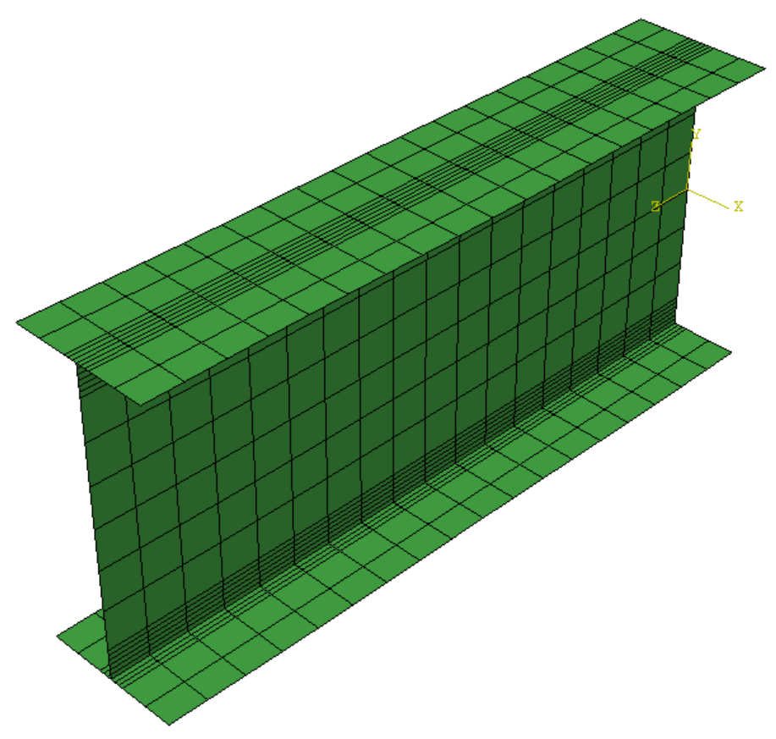
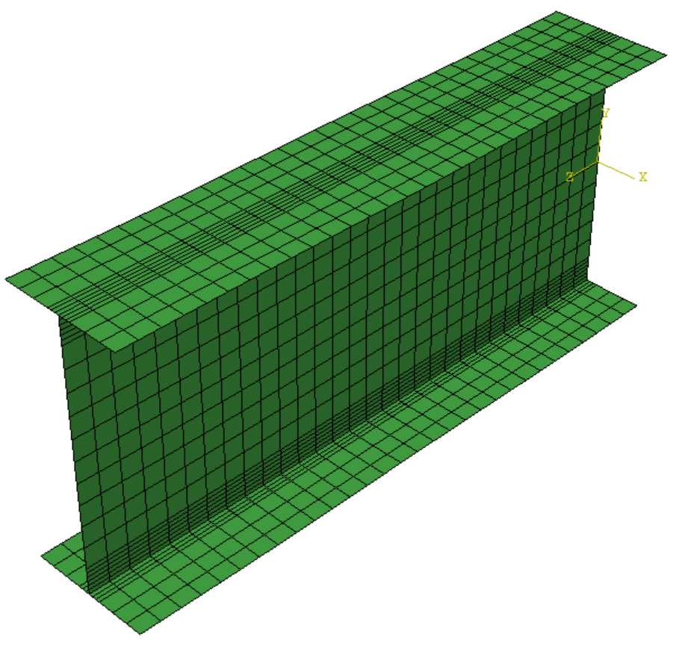


1. Design steel column : welded sections
Mesh sensitivity:
Coarse, Normal, Fine, Very fine
www.ulaval.ca
Notes:
All beams are going to be fabricated using fillet welds from 3 different plates along their lengths.
The classes of sections are 2 & 3 to consider the shortcoming of current designs

Slide 22
1. Design steel column : Parametric study
Parametric study:
Material | Manufacturing type | Sections | Length | GMNIA (L+G) | GMNIA (L) | GMNIA (G) | LBA | Nbr of simulations
S690 | Welded | 12 | 8 | 1 |  | 0 | 0 | 288
S460 | Welded | 12 | 8 | 1 |  | 0 | 0
S355 | Welded | 12 | 8 | 1 |  | 0 | 0
S690 | Welded | 12 | 8 | 0 |  | 1 | 0 | 288
S460 | Welded | 12 | 8 | 0 |  | 1 | 0
S355 | Welded | 12 | 8 | 0 |  | 1 | 0
S690 | HR | 12 | 8 | 1 |  | 0 | 0 | 288
S460 | HR | 12 | 8 | 1 |  | 0 | 0
S355 | HR | 12 | 8 | 1 |  | 0 | 0
S690 | HR | 12 | 8 | 0 |  | 1 | 0 | 288
S460 | HR | 12 | 8 | 0 |  | 1 | 0
S355 | HR | 12 | 8 | 0 |  | 1 | 0
- | - | 12*3 | 1 |  | 1 |  |  | 12
Total |  |  |  |  |  |  |  | 1188
www.ulaval.ca
Notes:
All beams are going to be fabricated using fillet welds from 3 different plates along their lengths.
The classes of sections are 2 & 3 to consider the shortcoming of current designs

Slide 23
1. Design steel column : welded sections
Parametric study result : Welded sections ‘S1’ I shape
Two types of geometrical imperfections must be taken into consideration: local and global imperfections (EN3)
Wo = h/200
Wg= Lcr/1000
www.ulaval.ca
Notes:
All beams are going to be fabricated using fillet welds from 3 different plates along their lengths.
The classes of sections are 2 & 3 to consider the shortcoming of current designs

Slide 24
1. Design steel column : welded sections
Parametric study result : Welded sections ‘S1’ I shape
www.ulaval.ca
Notes:
All beams are going to be fabricated using fillet welds from 3 different plates along their lengths.
The classes of sections are 2 & 3 to consider the shortcoming of current designs

Slide 25
1. Design steel column : welded sections
Parametric study result : Welded sections ‘S1’ H shape
www.ulaval.ca
Notes:
All beams are going to be fabricated using fillet welds from 3 different plates along their lengths.
The classes of sections are 2 & 3 to consider the shortcoming of current designs

Slide 26
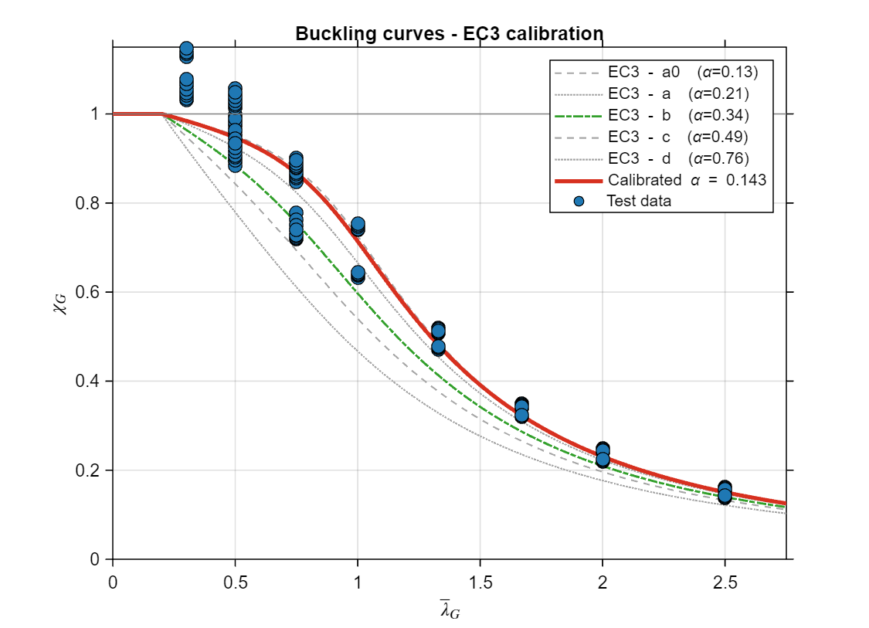
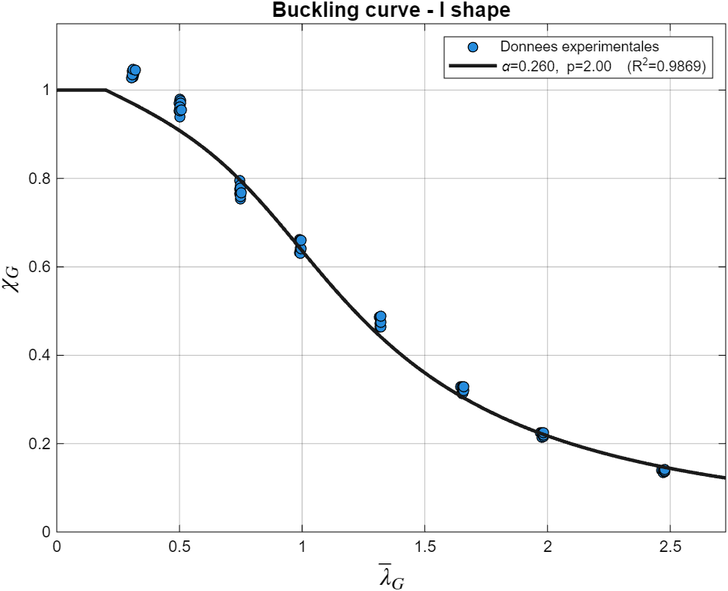
1. Design steel column :
Parametric study result :
www.ulaval.ca
Notes:
All beams are going to be fabricated using fillet welds from 3 different plates along their lengths.
The classes of sections are 2 & 3 to consider the shortcoming of current designs

Slide 27
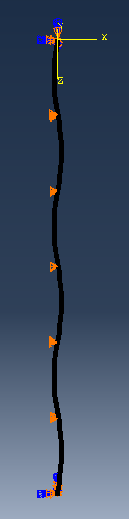
1. Design steel column :
Parametric study result :
www.ulaval.ca
Notes:
All beams are going to be fabricated using fillet welds from 3 different plates along their lengths.
The classes of sections are 2 & 3 to consider the shortcoming of current designs

Slide 28
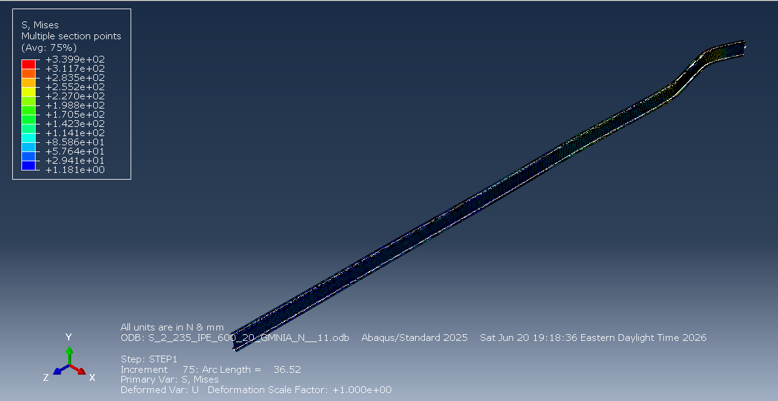
1. Design steel column :
Parametric study result : Spring
www.ulaval.ca
Notes:
All beams are going to be fabricated using fillet welds from 3 different plates along their lengths.
The classes of sections are 2 & 3 to consider the shortcoming of current designs

Slide 29
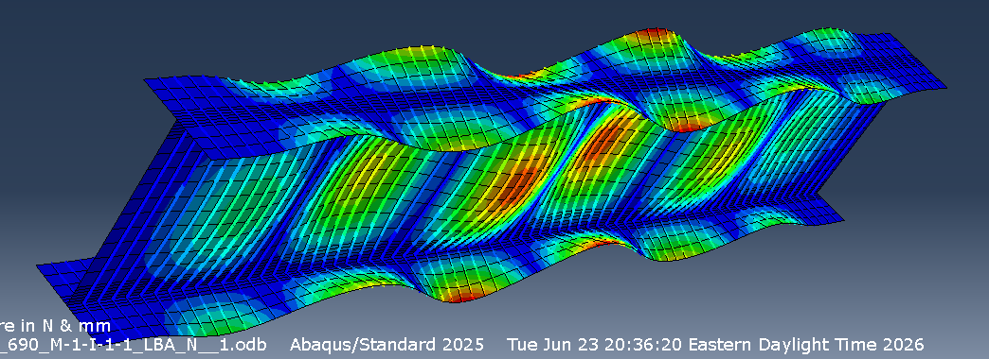
1. Design steel column :
Parametric study result
www.ulaval.ca
Notes:
All beams are going to be fabricated using fillet welds from 3 different plates along their lengths.
The classes of sections are 2 & 3 to consider the shortcoming of current designs

Slide 30
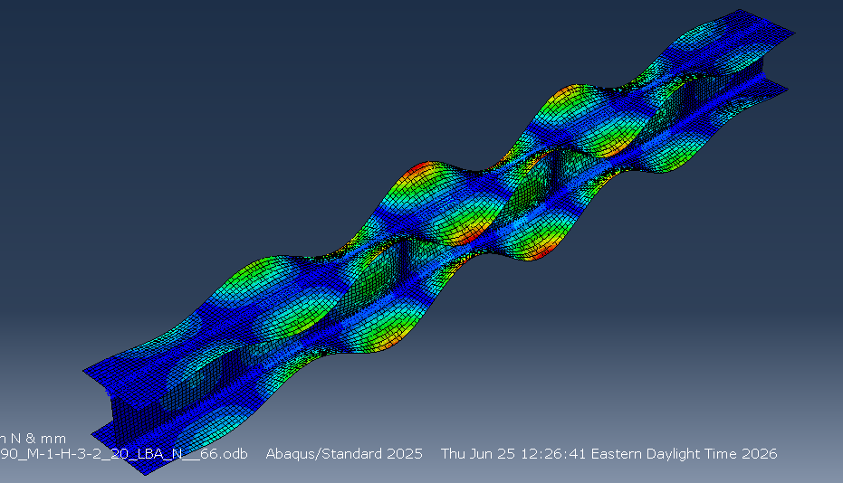
1. Design steel column :
Parametric study result
www.ulaval.ca
Notes:
All beams are going to be fabricated using fillet welds from 3 different plates along their lengths.
The classes of sections are 2 & 3 to consider the shortcoming of current designs

Slide 31
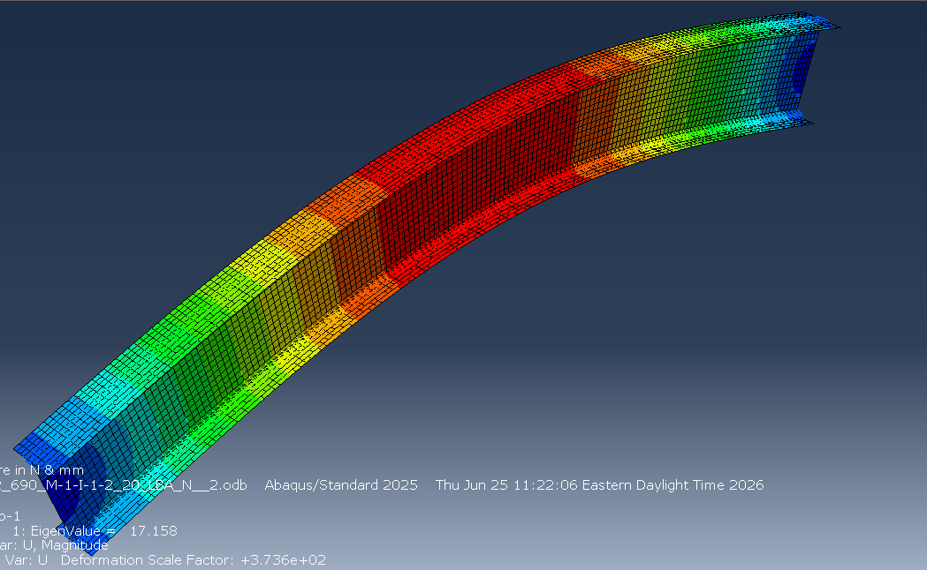
1. Design steel column :
Parametric study result
www.ulaval.ca
Notes:
All beams are going to be fabricated using fillet welds from 3 different plates along their lengths.
The classes of sections are 2 & 3 to consider the shortcoming of current designs

Slide 32
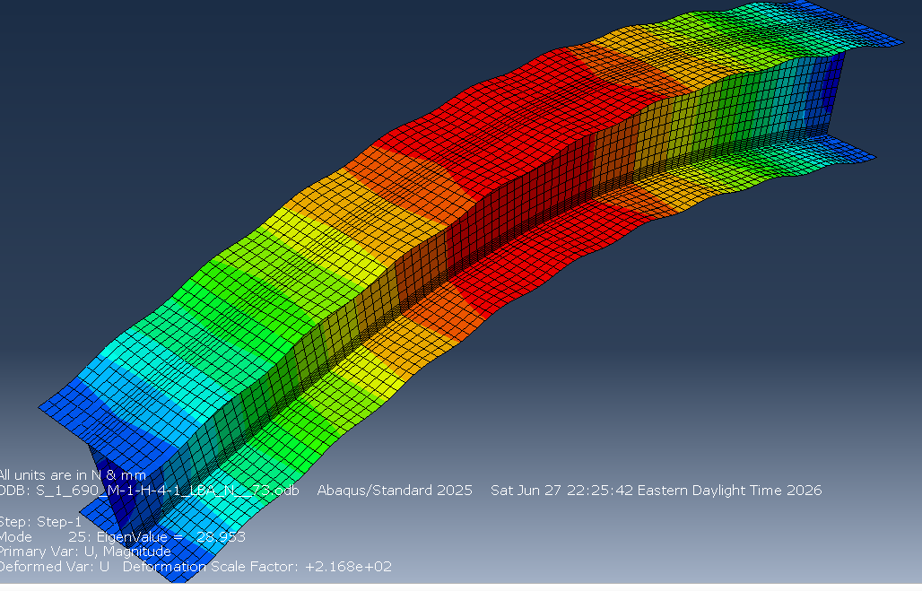
1. Design steel column :
Parametric study result
www.ulaval.ca
Notes:
All beams are going to be fabricated using fillet welds from 3 different plates along their lengths.
The classes of sections are 2 & 3 to consider the shortcoming of current designs

Slide 33
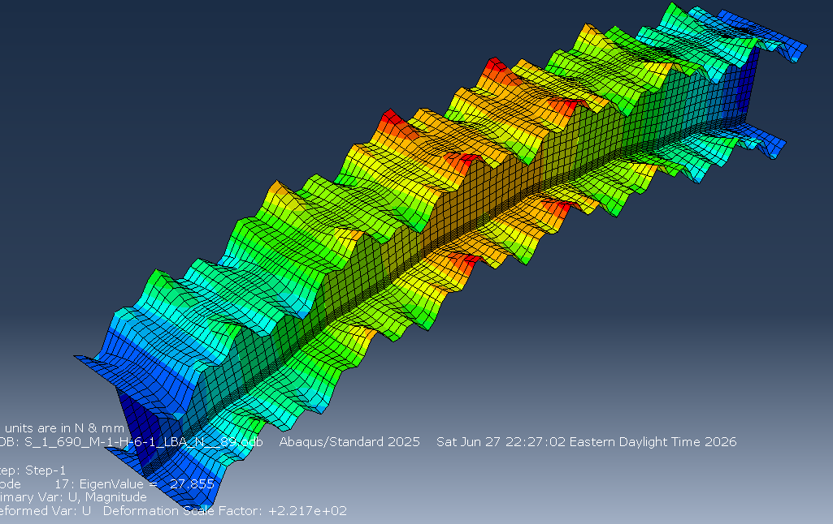
1. Design steel column :
Parametric study result
*BOUNDARY
RP1, 1, 2, 0.0
RP1, 5, 5, 0.0
RP1, 6, 6, 0.0
RP2, 1, 3, 0.0
RP2, 5, 5, 0.0
RP2, 6, 6, 0.0
SET_BC, 1, 1, 0.0
SET_BC2, 1, 1, 0.0
www.ulaval.ca
Notes:
All beams are going to be fabricated using fillet welds from 3 different plates along their lengths.
The classes of sections are 2 & 3 to consider the shortcoming of current designs

Slide 34
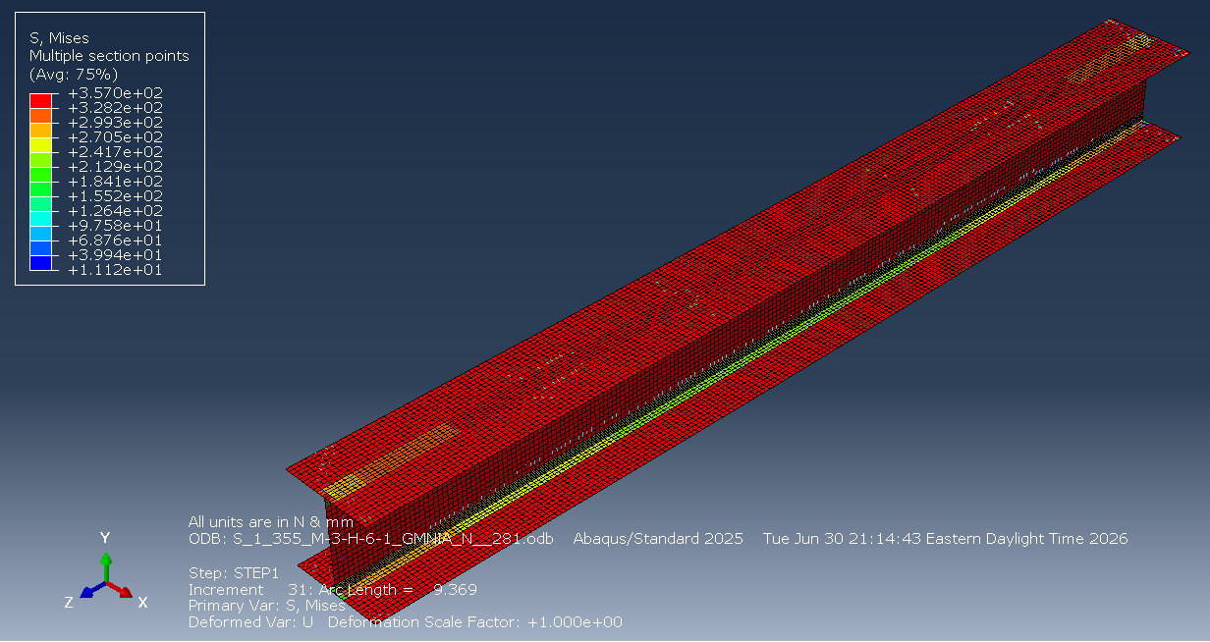
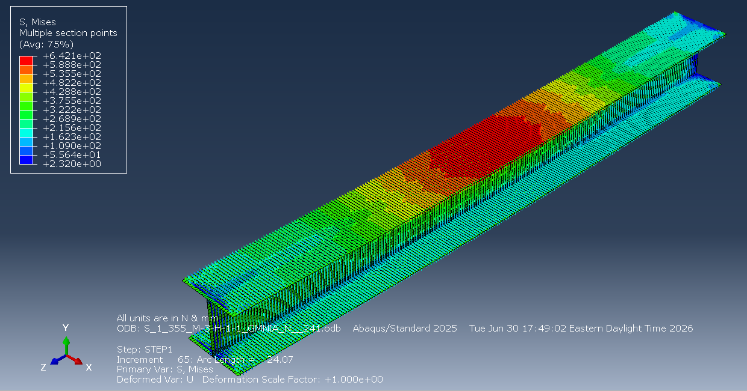
1. Design steel column :
Parametric study result
www.ulaval.ca
Notes:
All beams are going to be fabricated using fillet welds from 3 different plates along their lengths.
The classes of sections are 2 & 3 to consider the shortcoming of current designs

Slide 35
1. Design steel column : hot rolled sections
Parametric study result : Hot rolled sections ‘S2’
www.ulaval.ca
Notes:
All beams are going to be fabricated using fillet welds from 3 different plates along their lengths.
The classes of sections are 2 & 3 to consider the shortcoming of current designs

Slide 36
Thanks for your attention – Any questions?
www.ulaval.ca

